Slide 1
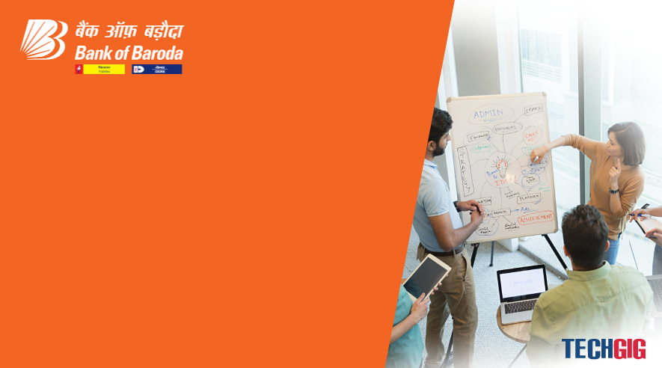
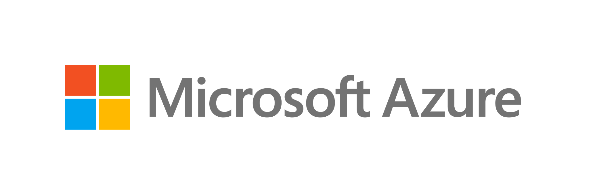
Bank of Baroda Hackathon - 2022
Technology Partner
Your Team Name :Those IT Guy’s
Your team bio :Abishek.S
:Boobalan.K
:Ezhil raj.S
:Mohan raj.J.E
Date:

Slide 2
Problem Statement?
Why did you decide to solve this Problem statement?
In current days ,everything is transforming into digital.So to avoid the manual intervention and to make good use of our advanced technology we decided to create an efficient and better soulution for this problem.

Slide 3
User Segment & Pain Points
Which user /advertiser segment would be early adopter of your product & why?
User Segments:
First the signature of the clients will be stored in the database.
The cheque will be scanned to verify the clients signature.
Verifying the Signature in the cheque with our advanced AI Tools.
Validate the cheque if it matches with the signature stored in the database.
Pain Points:
Sometimes cheque gets bounced and manual process takes too much time .

Slide 4
Pre-Requisite
What are the alternatives/competitive products for the problem you are solving?
Clients signature in a graph with crest and trough.
A Scanner which will work efficiently to scan a signature.
And finally the AI tool which is used for checking the signature in cheque with the signature in the database..

Slide 5
Azure tools or resources
Azure tools or resources which are likely to be used by you for the prototype, if your idea gets selected
To verify the signature in the cheque , ”sign tool” is used.
Using CLI extension for verification process.
IN-D signature verification is used to detect the signature in the documents and images.
OCR used to extract the handwritten text from image and document.

Slide 6
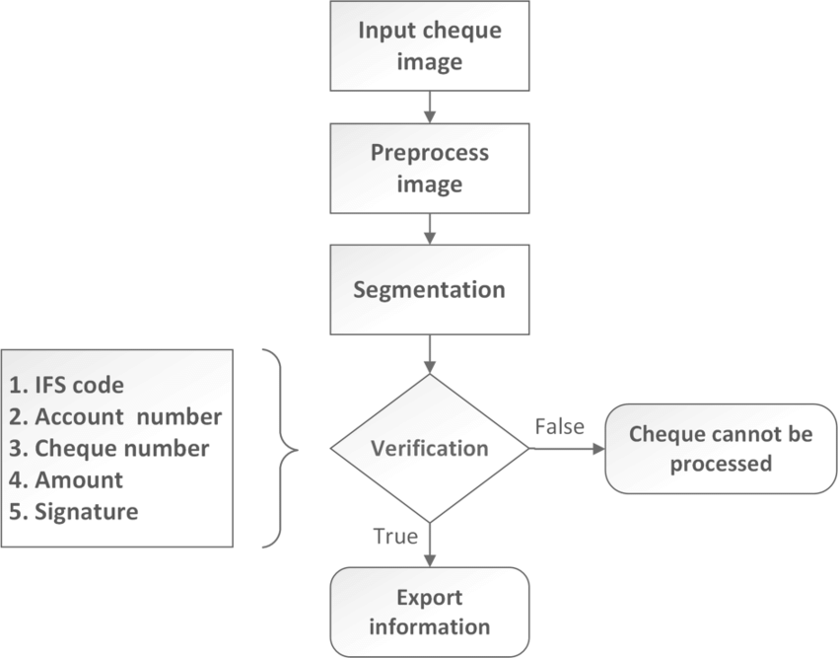
Any Supporting Functional Documents
Present your solution, talk about methodology, architecture & scalability

Slide 7
Key Differentiators & Adoption Plan
How is your solution better than alternatives and how do you plan to build adoption?
Form recognizer to extract IFSC code,Account numer,Cheque number and Amount.
The CLI is a cross- platform and open-source command-line tool that we can use to create or manage resources in the Azure.
The CLI allows the execution of commands through a terminal using interactive command-line prompts or a script.
Sign Tool is a command-line tool that digitally signs files and verifies signatures in files.
We used enhanced tools like IN-D and sign tool are used to solve this problem.

Slide 8
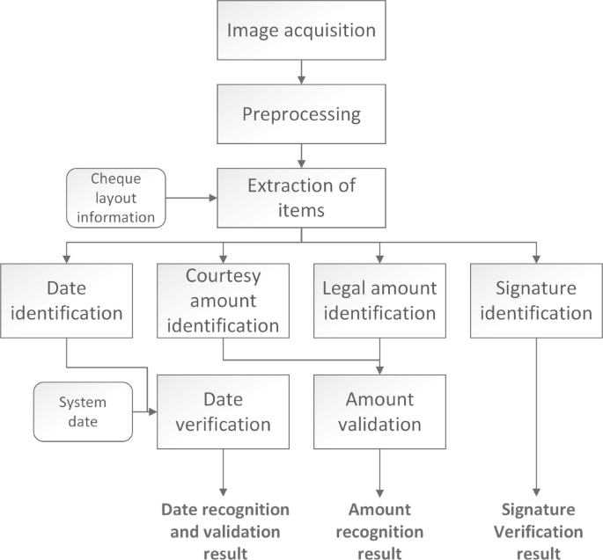
GitHub Repository Link & supporting diagrams, screenshots, if any
How far it can go?
GitHub Link: https://github.com/Itachi16022001/Those-IT-Guy-s.git
Diagram:

Slide 9
Thank you
ABISHEK S
BOOBALAN K
EZHIL RAJ S
MOHAN RAJ J E

